Slide 1
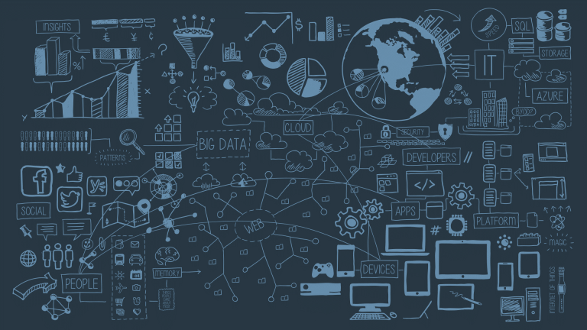
Introduction to Data Science

Slide 2
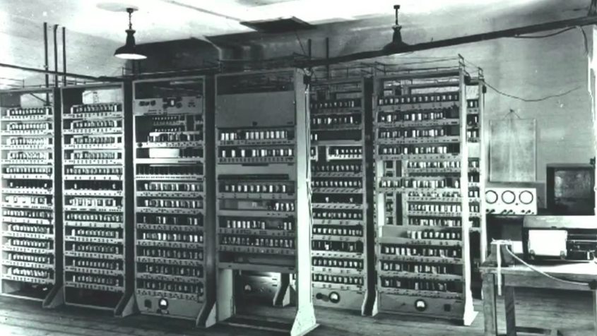
Notes:
1952 - Tic Tac Toe # Picture Above. First Human vs Computer race started.
1997 - Deep Blue - Chess ==> Exploring Solution Space
2011 - Watson - Jeopardy ==> Constructive Reasoning
2017 - Alpha Go - Go - [Possibilities > total no. atoms in this universe] ==> Developing Intuition

Slide 3
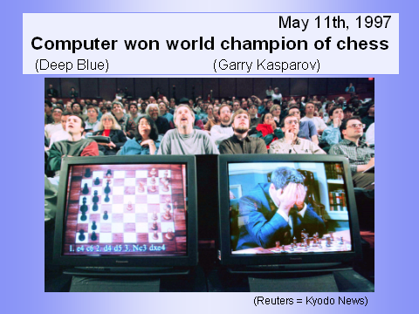
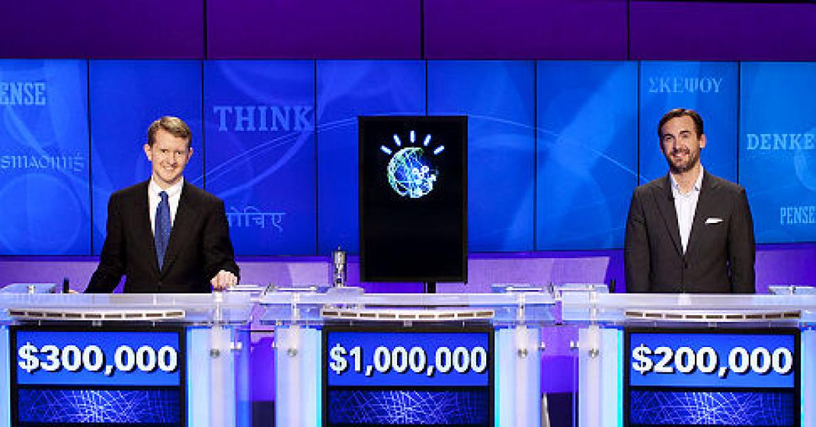
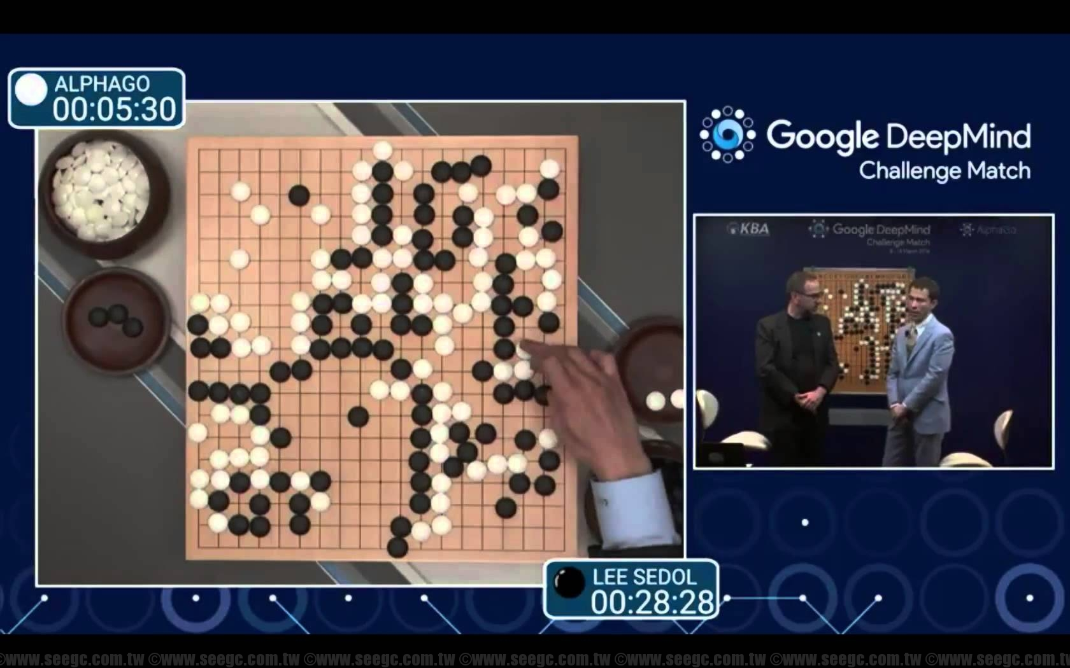
2011 Watson - Jeopardy
Data Science
1952 - Tic Tac Toe ⇒ Human vs Computer
1997 - Deep Blue - Chess ⇒ Exploring Solution Space
2011 - Watson - Jeopardy ⇒ Constructive Reasoning
2017 - AlphaGo - Go ⇒ Developing Intuition
In AlphaGo, no. of possibilities > total no. atoms in this universe.
Notes:
1952 - Tic Tac Toe
1997 - Deep Blue - Chess ==> Exploring Solution Space
2011 - Watson - Jeopardy ==> Constructive Reasoning
2017 - Alpha Go - Go - [Possibilities > total no. atoms in this universe] ==> Developing Intuition

Slide 4

Plan
Introduction
Definitions [ Data Science ]
What, Why and How
Examples
Data Science - In Action
Stages [DG, DC, DM, ME]
Regression & Clustering Models
Basics [ LR, GD ]
Real Life Application
Examples
Data Science Tools
Examples
Suggestions
Tips

Slide 5
What is Data Science?
Notes:
AQ - System Admins/Developers/ QA/ HR/
AQ - How many of you heard of Data Science? Can you explain me, what is data science to you?

Slide 6
What is Data Science?
da•ta
Factual information, especially information organized for analysis or used to reason or make decisions.
Computer Science Numerical or other information represented in a form suitable for processing by computer.
Values derived from scientific experiments.
sci·ence (sī′əns)
The observation, identification, description, experimental investigation, and theoretical explanation of phenomena. Ex. New advances in science and technology.
Such activities restricted to a class of natural phenomena. Ex. The science of astronomy.
A systematic method or body of knowledge in a given area. Ex. The science of marketing.
Archaic Knowledge, especially that gained through experience.
Notes:
Learn to draw - Newton’s observation of Apple falling from a Tree. Trojan Horse. Galileo - Watching ships moving, Kepler’s Law - Planetary System. Edision - bulb.

Slide 7
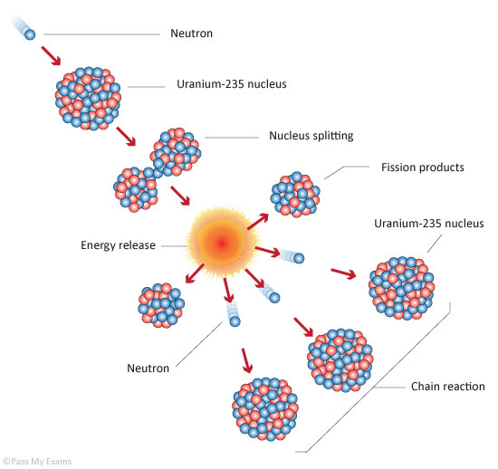
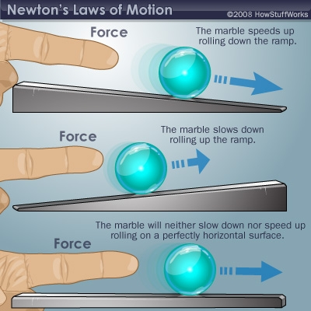
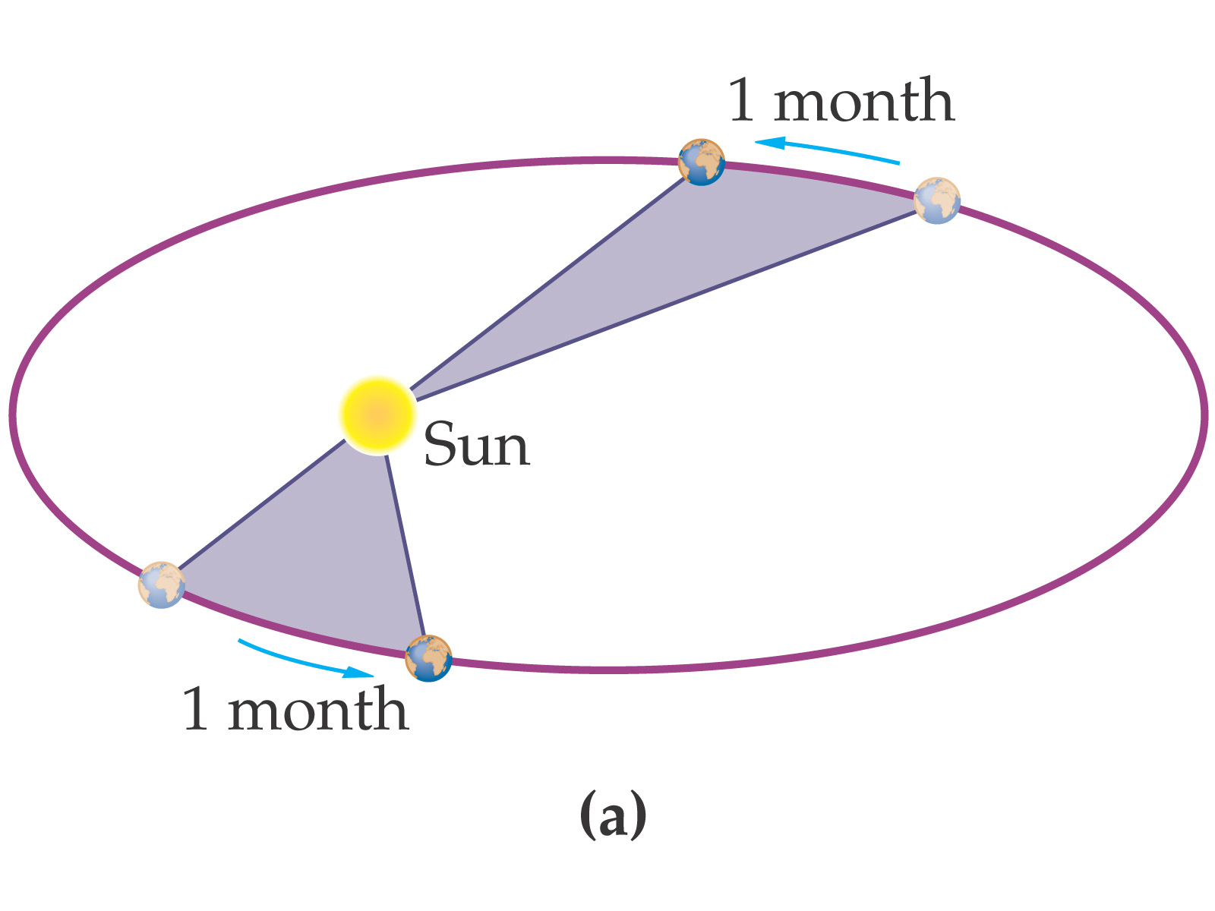
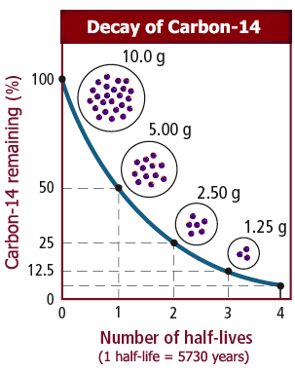
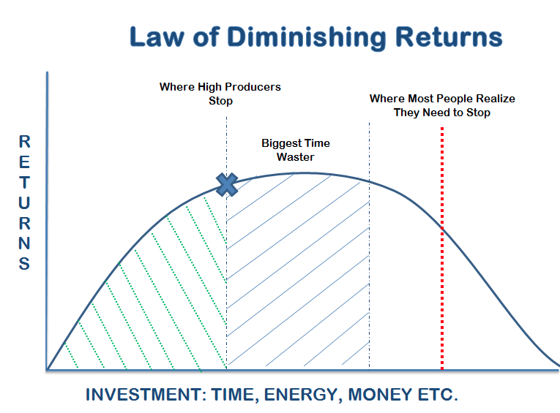
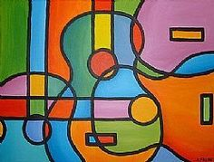
Data Science Examples
Notes:
> Newton’s Laws of Motions
> Laws of Diminishing Returns
> Kepler’s Laws of Planetary Motions
> U-235 Chain Reaction
> Arts - Music, Painting, Linguistics,..

Slide 8
Why Data Science?

Slide 9
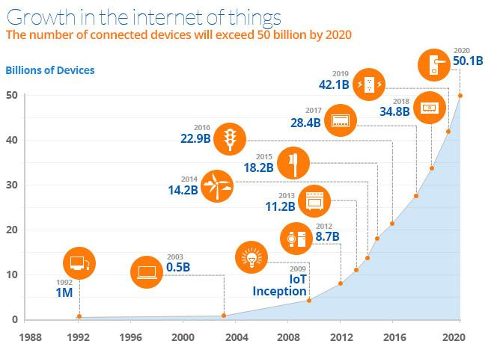
Growing Devices
Technological Advancements
Cheaper Storage
Faster Computations
IOT
RAD Tools
Bigger Questions?
Notes:
Usual Method: Data ⇒ Analysis ⇒ Rules/ Principles.
Data ⇒ Principles/Laws/Observation ⇒ Evaluation Experiments ⇒ Real Life Applications.
# Landing on Moon # Talking to a person at the other End of the world # Flying to other end of worlds

Slide 10
Information Explosion & Doubling Processing Power
Metcalfe's law states that the value of a telecommunications network is proportional to the square of the number of connected users of the system (n2).
Moore's law is the observation that the number of transistors in a dense integrated circuit doubles approximately every two years.
(Population - Thanks to Advanced Medical Sciences & Improving Health Care.)
Sources: Wikipedia
Notes:
Basic Fundamental

Slide 11
How to do Data Science?

Slide 12
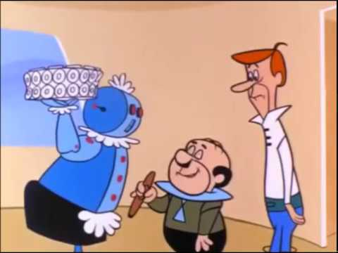
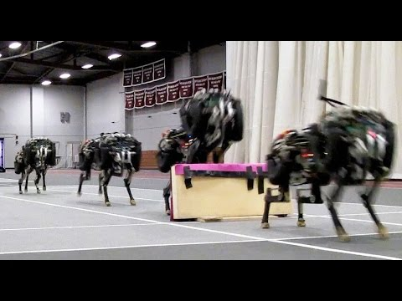
How to Data Science? - AI, ML
Rosey, Spacely, Jetson
MIT Cheetah Robot
Notes:
Artificial Intelligence. Actual Goal of - simulate a human being.
1 understand 2 (action) interact 3 expressive # they know table manners
Like a child, first achievement is talking first step.
1 understand situations 2 acting(judge height/speed/time)

Slide 13
How to do Data Science
You can use lots of sophisticated analytical & Business Intelligent tools and come to a simple understandable explanations.
(or)
You can also use, simple tools like calculators or excel sheet to generate simple and simple results.

Slide 14
Plan
Introduction
Definitions [ Data Science ]
What, Why and How
Examples
Data Science - In Action
Stages [DG, DC, DM, ME]
Regression & Clustering Models
Basics [ LR, GD ]
Real Life Application
Examples
Data Science Tools
Examples
Suggestions
Tips

Slide 15
Data Science - In Action

Slide 16
Stages of Data Science
Purpose
Relevant Data Collection
Wrangling(cleansing)*
Data Analytics
Feature Engg.*
Data Modelling*
Data Prediction*
Evaluation*
(*) ⇒ Repetitive stages
Reportings
Finalising Report
Data Product Building (software development)
  Architecture
  Development
  Testing
  Deployment
Notes:
Wrangling - Structuring Data. Preparations -> Numbers.

Slide 17
Data Model
Random Forest Model
  Bagging
SVM
  Linear Equation

Slide 18
Iris Dataset - Goal
<< Ipython Notebook >>

Slide 19
Plan
Introduction
Definitions [ Data Science ]
What, Why and How
Examples
Data Science - In Action
Stages [DG, DC, DM, ME]
Regression & Clustering Models
Basics [ LR, GD ]
Real Life Application
Examples
Data Science Tools
Examples
Suggestions
Tips

Slide 20
Data Science - Real Life App
Few applications that inspired me
Notes:
Experience is the best mentor.

Slide 21
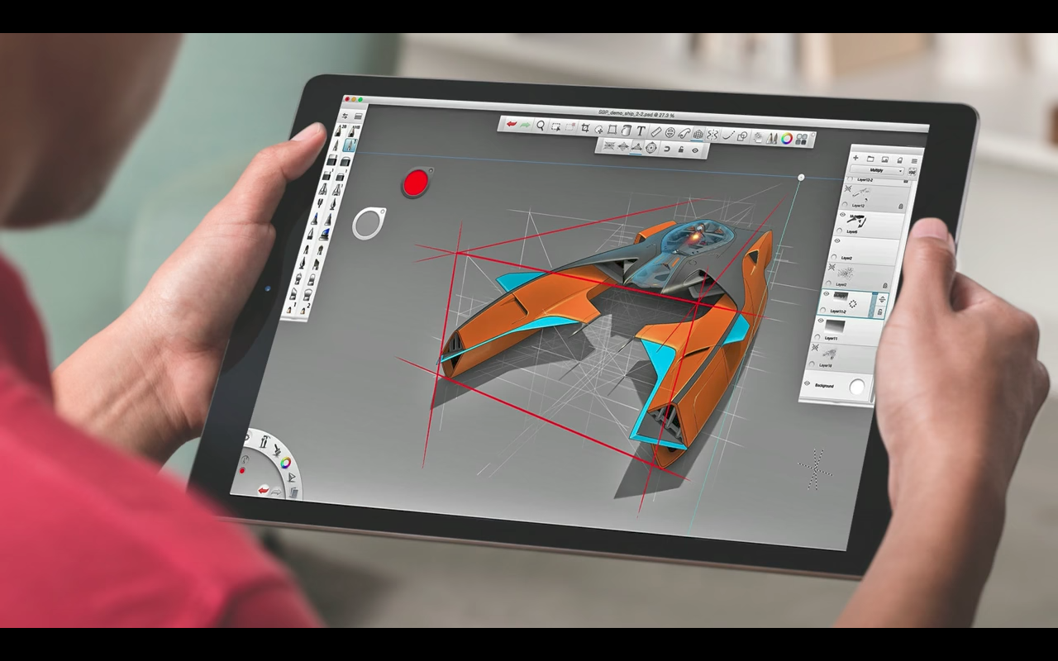
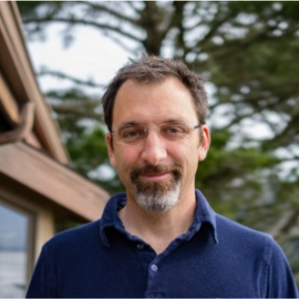
Passive Designs + AI
Maurice Cont
Director of Applied Research & Innovation
Autodesk, San Francisco Bay Area.
TED Talk: The incredible inventions of intuitive AI
Notes:
Passive Designs > Generative > Intuitive

Slide 22
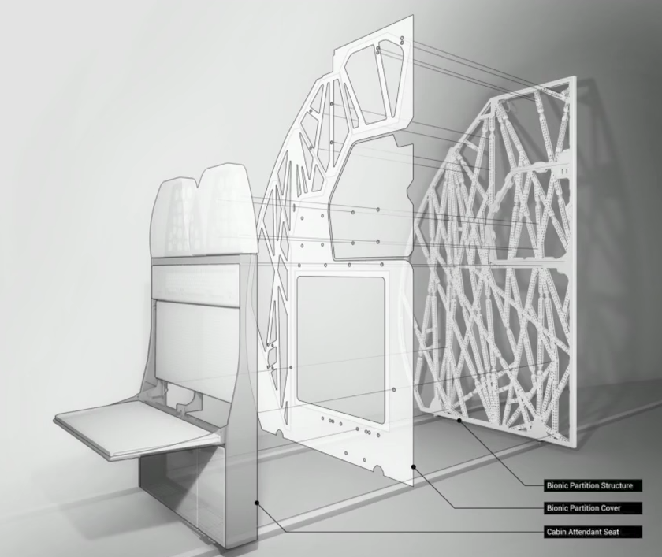
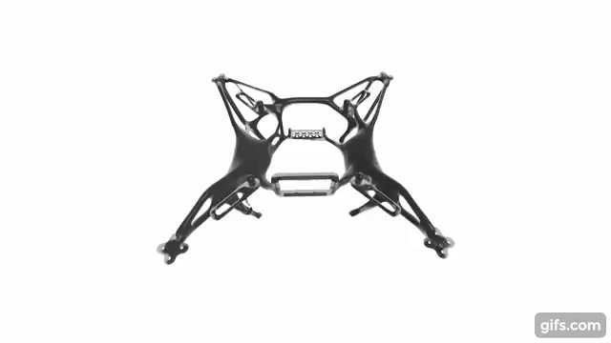
Generative Designs > Passive Designs
AI Designed Lightweight Cabin Partition
Airbus - A320
AI Designed Lightweight Drone Chassis
Notes:
Director of Applied Research & Innovation, Autodesk
3D Printed AI Design - Cabin Partition for Airbus - A320
Cars - Manufactured to Farmed
Buildings - Constructions to Growns
Cities - Isolated to Connected

Slide 23
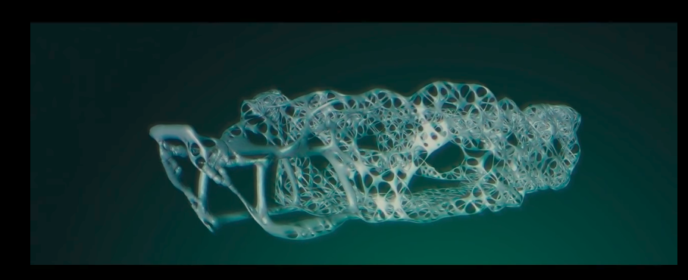
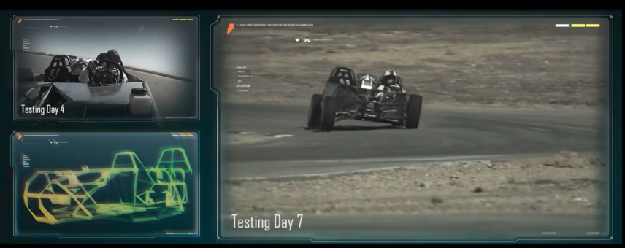
Generative Designs
Notes:
Traditions Race Car Chassis - Gave Nervous System - 4 Billions Data Points

Slide 24
Generative Designs
AI Designed Car Chassis
Notes:
4 Billions Data Points

Slide 25

Music XRay
Jimmy Lloyd Songwriter Showcase
Popular songs share Melody & Rhythm
Genere - 70
Cluster 60
Singer & Song Writer NY
http://www.heidimerrill.com/epk/index.html
Notes:
AI - Predicting if a Song will be HIT
Songs - Optimal Mathematical Patterns
25 Million Views

Slide 26

Pred Pole
2011 Santa Cruz Pred Pole
Crime, Location & Date-Time
https://www.predpol.com/
Results:
50% Crime Rate control
20% reduction in Crime Rate
Notes:
#### Minority Report is a 2002 American Sci-Fi
#### Director:Steven Spielberg
#### Starring:Tom Cruise, Colin Farrell, Samantha Morton, Max von Sydow

Slide 27
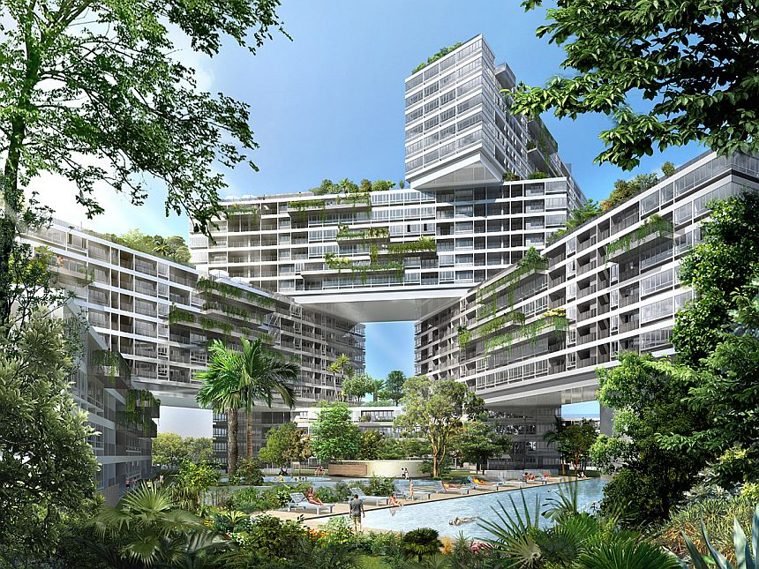
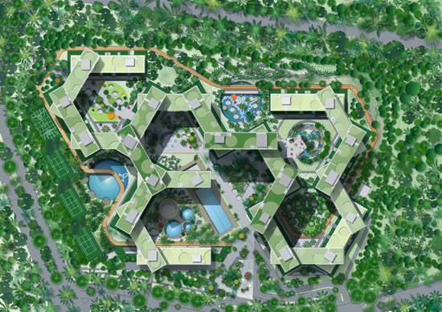
Generative Designs
Project - Interlace
Notes:
Project Interlace - Singapore
DayLights Problems + Energy Consumption + Water Bodies(micro Climates)

Slide 28
Plan
Introduction
Definitions [ Data Science ]
What, Why and How
Examples
Data Science - In Action
Stages [DG, DC, DM, ME]
Regression & Clustering Models
Basics [ LR, GD ]
Real Life Application
Examples
Data Science Tools
Examples
Suggestions
Tips

Slide 29
Data Science - Tools
Too many to name, but none of them are close perfection.
Notes:
Experience is the best mentor.

Slide 30
Data Science Tools
Languages: Scala, R, Python, Java, C#
Lib: Scikit, DeepNet, Tensor flow, Theano, H20
Frameworks: Apache Spark
These are some used by used us (Imaginea Labs - Data Sciences - 4th Floor, Hyd).
Notes:
Open Sourced Tools used us, if you are planning to use these - you can take some help.

Slide 31
Suggestions
Challenges in DS & Tips to who want to start.

Slide 32
Suggestions?
Data Preparation
  “Give me six hours to chop down a tree and I will spend the first four sharpening the axe”. Abraham Lincoln
  Python, Scala, Excel, Databases(regex).
Data Analytics
  “Seeing is believing”
  Python(Matplotlib, Seaborn), D3.Js, Excel.
Data Models
  “There are no perfect solutions, but some work better”
  Learn 2-3 types of Clustering, Regression Models(LR,RF,SVM,KNN,XGB)
Evaluation
  “A product not tested is broken by default”
  Accuracy, RMSE, Precision-Recall, F1 Score
Notes:
Add pyramid Model.

Slide 33
Questions?

Slide 34

Thank you
Notes:
Big Data - Blue whale.

